Slide 1
How to give a talk
Based on the “How to give a bad talk” by D. Patterson
Vangelis Markatos

Slide 2
Roadmap
How to give a bad talk
By D. Patterson
Some more advice
Summary

Slide 3
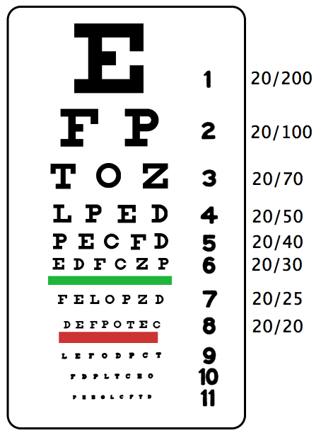
Do not cram everything together
Use at least 20pt font size for your fonts.
This text is 32pt large
This text is 24pt large
This text is 20pt large
This text is 16pt large
This text is 12pt large
People can not easily read this text
Do not put all your important points down here…

Slide 4
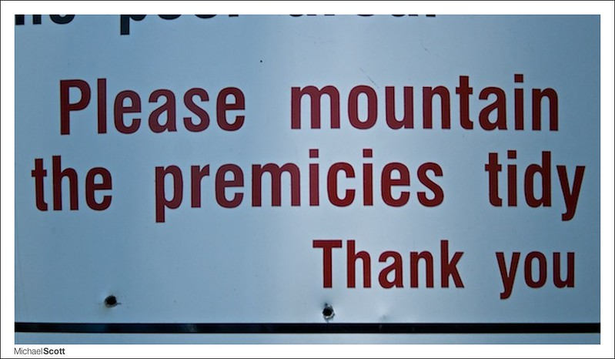
Be Neat
Use proper spelling, grammar, legibility
If you are slopi with speling and gramar
Peple wil think that you don’t kare

Slide 5
Be brief
Use short sentences
Use bullet points – use keywords
A long sentence, in which the writer delays the core to the middle of the sentence or in which the core is broken up so readers have to remember how the sentence started, is more difficult to read.

Slide 6
Use animation cautiously
Too much animation can become tiring
If you animate too much then
People might loose
the
Context of your talk

Slide 7
Use Color
To emphasize the important topics
It helps readers grasp the keywords
BUT
Do not overdo it – it may end up looking like a clown
CIRCO MEDRANO!!!

Slide 8
Use illustrations
Pictures – Graphs Charts
A picture is a thousand words!

Slide 9
Make eye contact
“Connect” with your audience
Do not block the screen

Slide 10
What to do if a talk is getting long?
Skip slides
Do not talk faster
Cover the important parts:
Summary
Conclusions

Slide 11
Practice
Practice
Practice, and then
Practice some more
Rule of thumb: Practice 10 (ten) times
Aloud
In front of an audience (once or twice)

Slide 12
Roadmap
How to give a bad talk
By D. Patterson
Some more advice
Summary

Slide 13
Some more advice
Ask yourself…

Slide 14
Do you want to give this talk?
Yes!I look forward to the talk!
Great! Start preparing
No!I do not want to do it…
My boss asked me… – I do not know the subject
I do not feel like it…
Then find somebody else to do it
Maybe… I am not sure…
Choose “yes” or “no”

Slide 15
Why are you giving this talk?
I would like to show off
show how smart I am
I would like to tell them
that I solved a hard problem
I would like to teach them
Explain a hard problem
Explain its solution

Slide 16
Who are you giving the talk for?
For me!
I would like to become better
I would like to become a better speaker
For them!
I would like them to become better

Slide 17
Who is your audience?
Scientists? PhDs?
Students?
Employees who need to be retrained?
I once spoke to Diplomats about cybersecurity
Do you think that I talked about buffer overflows?

Slide 18
What do I want the attendees to say after the talk?
The speaker must be really smart
I did not understand a word from what he said
or….
I (the attendee) am really smart
I understood a difficult problem
I even understood its solution!
Wow! I am smarter than I thought!

Slide 19
What do you want the audience to remember?
If they can remember one point after the talk
What would that be?
If they can remember two points after the talk
What would these two points be?

Slide 20
How to handle questions
Repeat the Question
So that the rest of the audience hears it
So that you get some time to think about it
If you know the answer
State the answer
If you do not know the answer say
I do not know – I am not sure
I will get back to you on this

Slide 21
How to handle an argument
Do not get involved in an argument
Never argue with the audience
If some person insists or is aggressive
Say something positive
“I see your point” – “I understand” – nod…
And defer the discussion for later – after the talk

Slide 22
Roadmap
How to give a bad talk
By D. Patterson
Some more advice
Summary

Slide 23
Summary
Be neat – use bullets - keywords
Use large fonts (20 pt font size minimum)
You give the talk for them (the audience)
Not for you (the speaker)
Practice – practice – practice
and then
Practice some more

Slide 24
Take Home Assignment
In 5 years from now: October 10 2024
Send me an email saying
If you still remember the lecture
What is the one point you still remember (if any)
!!!!THANK YOU!!!!!

Slide 25
How to give a talk
Based on the “How to give a bad talk” by D. Patterson
Vangelis Markatos

Slide 26
Credit
Photos from
Pexels, https://www.pexels.com
PxHere, https://pxhere.com
The Blue Diamond Gallery, https://www.thebluediamondgallery.com
MAX PIXEL.net
https://www.maxpixel.net

